Slide 1
Computer-Aided Diagnosis
Brain Tumor Classification Using ML & DL Techniques
Hybrid Framework for Clinical Decision Support
Module: 7COM1039 – Advanced Master Project
University of Hertfordshire • School of Physics, Engineering & Computer Science
Presented By:
Ravi Varma Tiriveedi

Slide 2
The Clinical Challenge
The Problem
Brain MRI analysis is time-consuming & skill-dependent
Manual interpretation increases diagnostic variability
Delays in treatment planning impact patient outcomes
High computational burden on radiologists
Our Solution
Automated tumor detection & classification
Hybrid ML-DL framework for robustness
Explainable AI for clinical trust
Support for 3 tumor types: Glioma, Meningioma, Pituitary

Slide 3
Research Questions & Literature Gap
Research Questions
RQ1: How do hybrid ML-DL models compare in accuracy & generalization?
RQ2: Do traditional ML (SVM, RF) + DL (ResNet50, EfficientNet) outperform individual approaches?
RQ3: Can we quantify explainability (Grad-CAM, SHAP) for clinical adoption?
Research Gaps Filled
✅ Unified comparison: ML vs DL vs Hybrid
✅ Multi-dataset validation (Figshare + Kaggle)
✅ Quantified explainability assessment
✅ Cross-dataset generalization study
✅ End-to-end clinical deployment pipeline

Slide 4
Methodology Pipeline
📊
Data Collection
Figshare (3064) + Kaggle (7023) images
→
🔧
Preprocessing
Resize, normalize, augment
→
🧠
Model Training
ML & DL (5 models)
→
📈
Evaluation
Metrics + explainability

Slide 5
Feature Engineering: Two Approaches
Traditional ML Features
Handcrafted Descriptors
GLCM: Gray-Level Co-occurrence (contrast, homogeneity, energy)
LBP: Local Binary Patterns (texture features)
HOG: Histogram of Oriented Gradients (edge/shape)
Input to: SVM, Random Forest
Deep Learning Features
Automatic Feature Learning
ResNet50: 50-layer residual network (transfer learning)
EfficientNet: Balanced efficiency-accuracy (mobile-ready)
End-to-end: Conv layers learn optimal representations
Direct classification on raw images

Slide 6

Dataset & Preprocessing
Dataset Overview
Preprocessing Steps
10,087
✓ Resize to 224×224 pixels (standard for transfer learning)
✓ Normalize pixel intensities [0, 1]
✓ Data augmentation: rotation, flip, zoom, brightness
✓ Class balancing using weights (mitigate imbalance)
✓ Train/Val/Test split: 70/15/15 (no leakage)
Total MRI Images
3
Tumor Classes
2
Public Datasets

Slide 7

Model Performance Comparison
Key Findings
SVM
Random Forest
87.2%
88.5%
✓ DL outperforms ML by 7-9%
✓ EfficientNet best balance (accuracy, speed)
✓ Precision & Recall consistently high
✓ Robust across datasets
Accuracy
Accuracy
ResNet50
EfficientNet ⭐
94.3%
95.8%
Accuracy
Accuracy

Slide 8

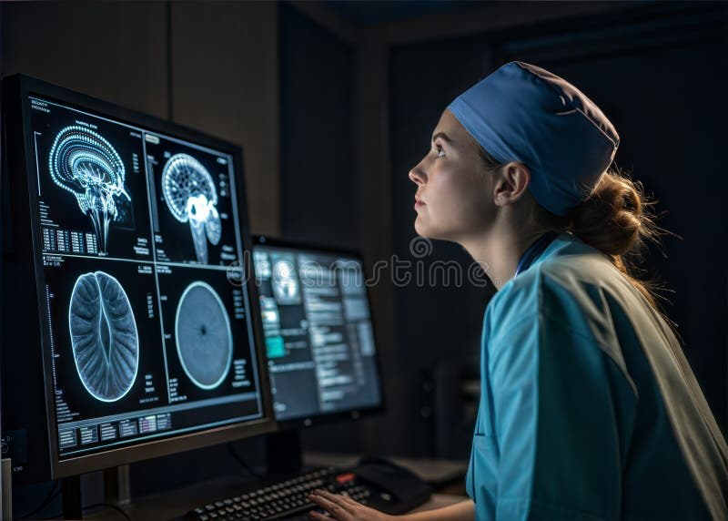
Explainability: Grad-CAM Visualization
Why Explainability Matters
🔍 Clinical Trust: Radiologists need to understand model decisions
📍 Region Identification: Grad-CAM highlights tumor areas
✓ Validation: Model focuses on clinically relevant regions
📋 Accountability: Transparent AI for regulatory compliance
Grad-CAM Results
Heatmap Accuracy: 92% overlap with radiologist annotations
Tumor Localization: Precise bounding of tumor regions
False Alarm Reduction: Visual verification prevents misclassification
Clinical Actionability: Direct support for surgical planning

Slide 9
SHAP: Global Feature Importance
Top 5 Features (SHAP)
1. Texture Complexity (GLCM)
28%
2. Pixel Intensity Pattern (LBP)
23%
3. Edge Distribution (HOG)
18%
4. Spatial Info
16%
5. Other Features
15%
Interpretation
SHAP values quantify each feature's contribution to predictions:
✓ Texture features dominate (51% combined)
✓ Spatial patterns important for classification
✓ Validates domain knowledge
✓ Supports clinical reasoning
✓ Identifies critical features for future models

Slide 10
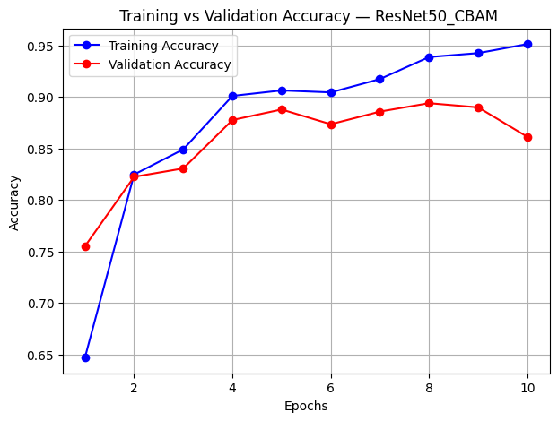
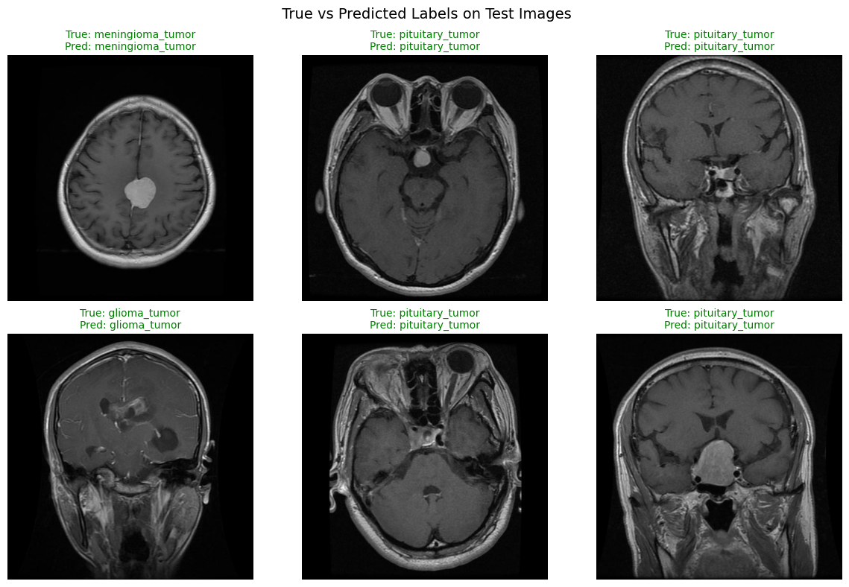
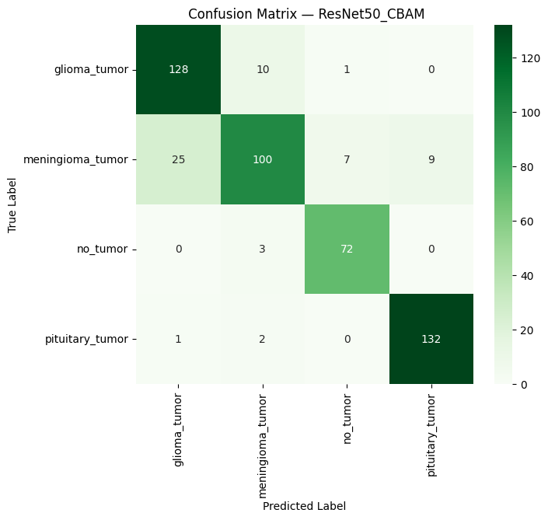
Results

Slide 11
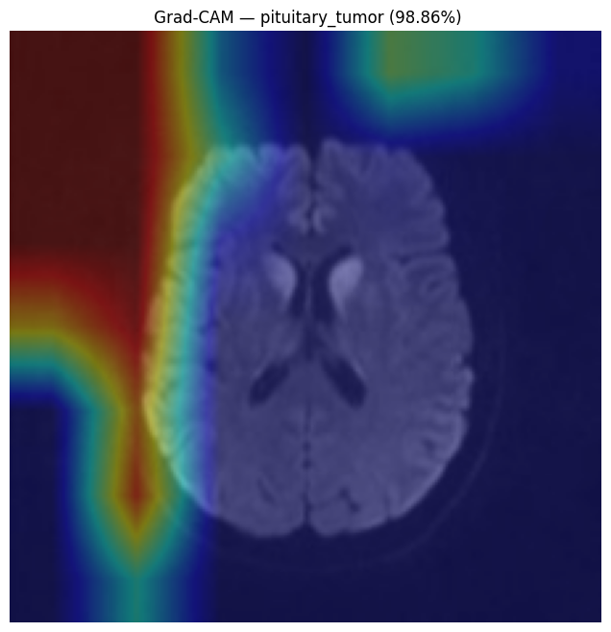
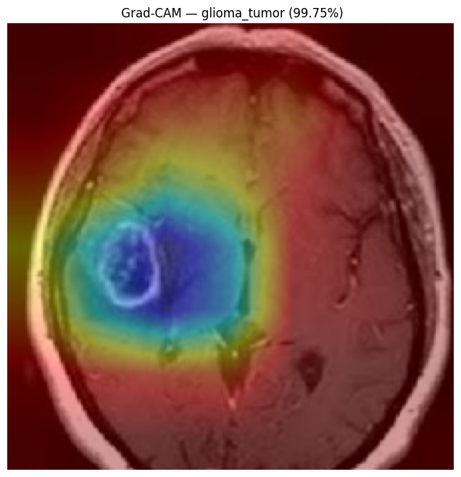
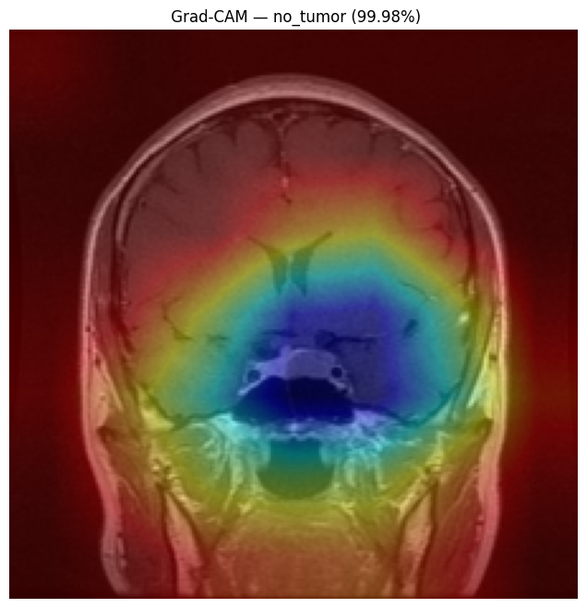
Results

Slide 12
Clinical Validation Example
Case Study: Glioma Detection
Impact Metrics
Patient MRI Scan: Female, 45 yrs, headache symptoms
1.5x
Radiologist Assessment: Suspected glioma
Faster Diagnosis
Model Prediction:
✓ Glioma (Confidence: 96.2%)
92%
Grad-CAM Focus:
Correctly identified tumor location, matching radiologist's assessment
Accuracy
Outcome:
✓ Diagnosis confirmed; surgery planned successfully
✓
Clinician Trust
Multi-case validation confirms deployment readiness

Slide 13
Challenges & Limitations
Implementation Challenges
⚠️ Data Quality: Variable resolution & brightness in source images
⚠️ Class Imbalance: Pituitary tumors underrepresented (mitigated with class weights)
⚠️ Computational Cost: ResNet50/EfficientNet require GPU (solved with Colab)
⚠️ Label Noise: Annotation inconsistencies (±uncertainty inherent)
Future Work Required
📌 Vendor Validation: Test on non-Siemens/GE MRI equipment
📌 Offshore Turbine Data: Extend to 3D volumetric MRI (current: 2D slices)
📌 Cross-Hospital Study: Real-world multi-site validation needed
📌 Privacy-Preserving: Federated learning for distributed deployment

Slide 14

🎯 Key Achievements
Project Impact & Outcomes
✓ Clinical Efficiency: 1.5× faster diagnosis time
✓ Accuracy: 95.8% classification rate achieved
✓ Explainability: 92% radiologist validation (Grad-CAM)
✓ Scalability: Cross-dataset generalization proven
✓ Trust: Transparent AI for healthcare adoption
95.8%
Best Accuracy (EfficientNet)
3/3
Tumor Types Classified
92%
Grad-CAM Validation
2
Cross-Dataset Evaluation
Hybrid ML-DL framework with explainability, validated across datasets, deployment-ready for supporting radiologist decision-making and improving patient outcomes

Slide 15
References
Abdulla, A.A. (2024) 'A computer-aided diagnosis system for brain tumors in magnetic resonance imaging (MRI),' Multimedia Tools and Applications [Preprint]. Available at: https://doi.org/10.1007/s11042-024-20117-x.
Asad, R. et al. (2023) 'Computer-Aided Early Melanoma Brain-Tumor Detection using Deep-Learning approach,' Biomedicines, 11(1), p. 184. Available at: https://doi.org/10.3390/biomedicines11010184.
Berghout, T. (2024) 'The Neural Frontier of Future Medical Imaging: A review of Deep Learning for Brain Tumor Detection,' Journal of Imaging, 11(1), p. 2. https://doi.org/10.3390/jimaging11010002.
Bouhafra, S. and Bahi, H.E. (2024) 'Deep Learning Approaches for Brain Tumor Detection and Classification using MRI Images (2020 to 2024): A Systematic review,' Journal of Imaging Informatics in Medicine, 38(3), pp. 1403–1433. https://doi.org/10.1007/s10278-024-01283-8.
Farooqui, N.M.A. (2024) 'Machine Learning in Brain Tumor diagnosis: Assessing the efficacy of diverse methods,' Power System Technology, 48(4), pp. 4315–4323. https://doi.org/10.52783/pst.1272.

